Slide 1

FINAL PRESENTATION · R26-IT-095
Intelligent Project Management System for Undergraduate Students
Supervisor: Prof. Samantha Rajapaksha | Co-supervisor: Ms. Lashika
Bandara N.D.M. · Lekamge R.L.M.D. · Kulathunga S.A.I.K. · Rashmika R.M.D.
Notes:
Welcome the panel. Introduce the four members and the project in one sentence: an AI-supported, human-supervised system for the undergraduate project lifecycle.
1

Slide 2

Problem in brief
The Problem
Our Solution
• Multi-objective team and project allocation.
• Evidence-linked planning and scheduling.
• Advisory proposal quality and mentorship support.
• Contribution and risk analytics for supervisors.
• Team allocation may overlook skill–project fit.
• Proposals do not automatically become trackable plans.
• Proposal weaknesses can be identified late.
• Raw commits and meetings obscure uneven contribution
One academic lifecycle • Four specialized components • Human oversight at decision points
IPMS / R26-IT-095
Notes:
30-second elevator pitch: Group projects start with random teams, hand-made plans and late discovery of problems. IPMS adds one AI component for each stage of the lifecycle, and keeps supervisors in charge of every final decision.
2

Slide 3
Design Excellence Over Existing Solutions
Existing platforms offer useful capabilities; IPMS introduces undergraduate-focused intelligent decision support.
RESEARCH AREA
EXISTING TOOLS
IPMS RESEARCH CONTRIBUTION
Team Formation
CATME
NSGA-II optimization of technical fit and student preferences
Project Planning
Jira · Microsoft Project
Proposal-to-WBS extraction and adaptive workload scheduling
Quality Assessment
Turnitin · Moodle
Semantic weakness analysis and mentorship recommendations
Risk & Contribution
GitHub · Jira
Weighted Contribution Index and 12-feature risk classification
KEY DIFFERENCE Four specialized components in a common, human-supervised academic system.

Slide 4

Intelligent Team Formation and Topic Feasibility Analysis
Brief description
How it fits the whole solution
Forms teams and assigns projects with Heuristic-Seeded NSGA-II. Technical requirement fit and student preference are separate objectives, and staff choose from the Pareto alternatives.
Produces the official ACTIVE team, project and supervisor allocation that later stages use. It is exposed by REST and already shown in the Scheduling team view.
IT22114662
Bandara N.D.M.
Data flow
Cohort and project workbook (Excel)
›
Validation of profiles and requirements
›
NSGA-II optimisation
›
Staff review and confirm
›
ACTIVE allocation via REST API
Limitation
Competencies are self-reported and the real-response test used one 60-student cohort. Automatic import of team IDs into Scheduling is not yet verified.
IT22114662 | Bandara N.D.M. | R26-IT-095
5
Notes:
Explain the two objectives: technical requirement deficit and preference dissatisfaction. Staff still choose the final allocation.
5

Slide 5
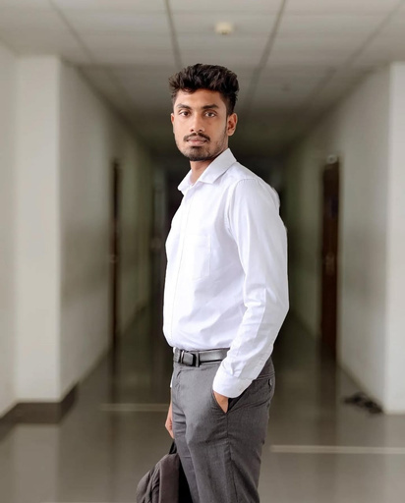
Adaptive Scheduling and Generative Project Planning
Brief description
How it fits the whole solution
Turns a proposal PDF into a dated, versioned Gantt plan using rule-based WBS extraction, an effort estimate, dependency-aware dates and live LPT workload balancing, with evidence review and academic-event scheduling.
Takes the confirmed teams from Team Formation and gives supervisors a plan, with task evidence, to track progress against.
IT22117014
Lekamge R.L.M.D.
Data flow
Proposal PDF and group data
›
WBS and effort extraction
›
Dependency-aware dates
›
LPT task assignment
›
Versioned Gantt and evidence
Limitation
WBS extraction was tested on three structured proposals. The JIRA-based classifier is a proxy, effort errors are large, and a fresh upload and webhook trace was not retained.
IT22117014 | Lekamge R.L.M.D. | R26-IT-095
6
Notes:
Mention that the earlier T5 and EDF design was replaced by the final rule-based extraction and LPT assignment described in the report.
6

Slide 6
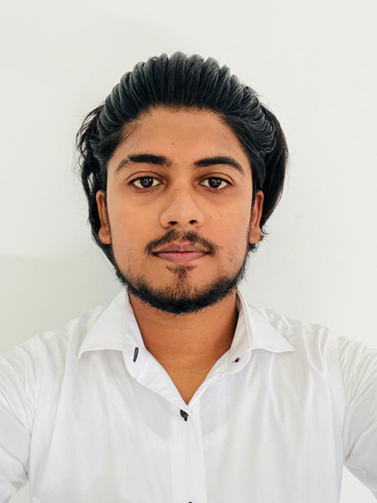
Automated Quality Assessment and Adaptive Mentorship
Brief description
How it fits the whole solution
Analyses proposal PDFs with structure checks, sentence embeddings with Logistic Regression, TF-IDF with Ridge, historical-feedback retrieval and learning-resource suggestions. Every output is advisory.
Supports proposal quality and mentoring in the lifecycle. Supervisors review each proposal version and finalise the feedback, so academic judgement stays with them.
Rashmika R.M.D.
IT22101624
Data flow
Proposal PDF
›
Structure validation
›
Semantic analysis and grading
›
Feedback retrieval and resources
›
Supervisor review and final feedback
Limitation
Final model metrics have not been measured yet and the stated values are targets. The backend test run was blocked, and no exchange with the other components is verified.
IT22101624 | Rashmika R.M.D. | R26-IT-095
8
Notes:
Confirm with Rashmika which models are final. This slide follows the common report (MiniLM and Logistic Regression, TF-IDF and Ridge).
8

Slide 7

Predictive Risk Monitoring and Contribution Analytics
Brief description
How it fits the whole solution
Calculates a weighted Contribution Index from commits, task completion, collaboration, issue resolution and code quality, and predicts High, Medium or Low project risk with a 12-feature classifier.
Gives supervisors execution-stage visibility through a dashboard and email alerts. It reads GitHub and Jira directly and runs independently of the other components.
Kulathunga S.A.I.K.
IT22109576
Data flow
GitHub and optional Jira APIs
›
Feature extraction
›
Contribution Index and risk model
›
Dashboard
›
HIGH RISK email alert
Limitation
  Relies on GitHub and Jira records. Non-coding contributions may be missed.Risk predictions are not always accurate. Activity does not always reflect actual effort.Focused on undergraduate software projects.itHub API request limits, especially for unauthenticated access to public repositories, may restrict data retrieval.
7
IT22109576 | Kulathunga S.A.I.K. | R26-IT-095
Notes:
Be clear that the accuracy figure is synthetic. What was demonstrated live is GitHub and Jira retrieval, the dashboard and the delivered HIGH RISK email.
7

Slide 8
Results, limitations and future improvements
Team Formation
Scheduling
Risk Monitoring
Proposal Assessment
0.9479
73 / 75
Implemented & Tested
Implemented
mean hypervolume, versus 0.6532 for unseeded NSGA-II
explicit WBS tasks recovered from three test proposals
Tested with real undergraduate GitHub projects. F1-0.98
Evaluated by 3 industry experts
version-aware supervisor review workflow
1,000 students and 250 projects in about 30 s
6 of 6 focused database tests passed
GitHub/Jira retrieval and HIGH RISK email delivered
Final model metrics still to be measured
Limitations
Future improvements
  Limited Scope: Primarily designed for undergraduate projects, requiring further improvements for industrial use.
  External Dependencies: API availability, internet connectivity, and third-party services may affect functionality.
  Limited Customization: The system may need adaptation for different university requirements and assessment criteria.
  Data Quality: Incomplete or inaccurate input data may affect system outputs.
  Optimize performance to support larger numbers of students and projects.
  Strengthen data privacy, authentication, and access control.
  Support additional platforms and improve API request handling.
  Introduce more detailed reports, personalized recommendations, and early risk alerts.
  Adapt the system for university-wide implementation.
Lecturer Review: IPMS prototype demonstrated to lecturers, with feedback collected for future improvements.
10
Notes:
Quote only these verified figures. The Risk figure is synthetic. If a supervisor gave feedback on the prototype, add the quote to this slide.
10

